Slide 1
Banker’s Algorithm
Kavitha Viveganandan

Slide 2
What is the Banker’s Algorithm?
The Banker's algorithm is a resource allocation & deadlock avoidance algorithm developed by Edsger Dijkstra
Tests for safety by simulating the allocation of pre-determined maximum possible amounts of all resources, and then makes a "safestate“check to test for possible deadlock conditions for all other pending activities, before deciding whether allocation should be allowed to continue.

Slide 3
What is a safe state?
A state is considered safe if it is possible for all processes to finish executing.
Safe state is one where
(1) It is not a deadlocked state
(2) There is some sequence by which all requests can be satisfied.
To avoid deadlocks, we try to make only those transitions that will take you from one safe state to another. We avoid transitions to unsafe state.

Slide 4
Requirements
The Banker's algorithm is run by the operating system whenever a process requests resources. The algorithm prevents deadlock by denying or postponing the request if it determines that accepting the request could put the system in an unsafe state.
Resources For the Banker's algorithm to work, it needs to know three things:
(1) How much of each resource each process could possibly request
(2) How much of each resource each process is currently holding
(3) How much of each resource the system has available.

Slide 5
The Algorithm
The banker’s algorithm considers each request as it occurs, and see if granting it leads to a safe state.
If it does, the request is granted; otherwise, it is postponed until later.
To see if a state is safe, the banker checks to see if he has enough resources to satisfy some customer. If so, those loans are assumed to be repaid, and the customer now closest to the limit is checked, and so on.
If all loans can eventually be repaid, the state is safe and the initial request can be granted.

Slide 6
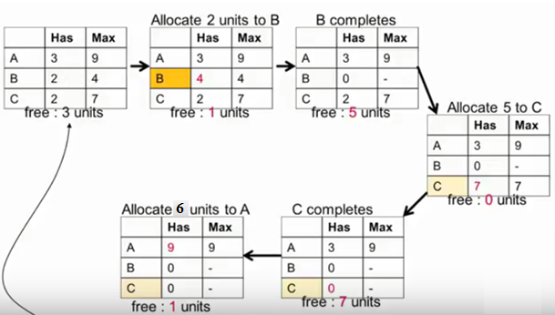
Example
Assuming there are three processes A, B and C with total 10 units resources.
The resources currently allocated to each process and the maximum resources each process need are specified as in the figure below.

Slide 7
Example Continued
To avoid deadlocks, we try to make only those transitions that will take you from one safe state to another.
We avoid transitions to unsafe state. First 2 units are allocated to B and we will have 5 free units after B finished.
Next, 5 units can allocated to C and we will have 7 free units after C finished, then we allocated 6 free units to A and A can finish as shown in figure 3.
We successfully avoid the deadlock by using this specific process handling sequence.

Slide 8
Conclusion
The banker’s algorithm is a resource allocation and deadlock avoidance algorithm developed by Dijkstra
Tests for safety by simulating the allocation of pre-determined maximum possible amounts of all resources, and then makes a "safestate" check to test for possible deadlock conditions for all other pending activities, before deciding whether allocation should be allowed to continue.

